Slide 1
Classifying collision severity
Birkmayer Bendegúz, Burkus Ádám, Rácz Bojta, Sztreborny Attila, Tuboly Roland

Slide 2
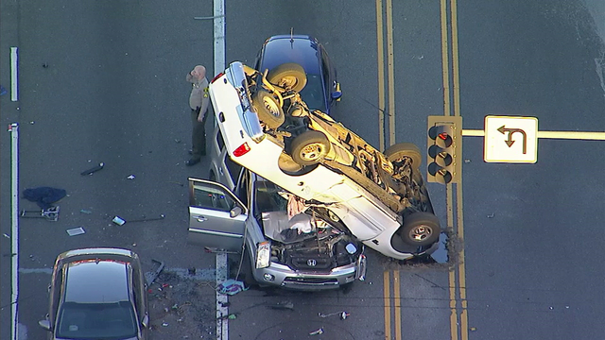
Question of Life or Death
Last year in Hungary
Total accidents | 14 687
Serious injuries | 4 143
Deaths | 446
How can we classify road collisions? What are the determinants?

Slide 3
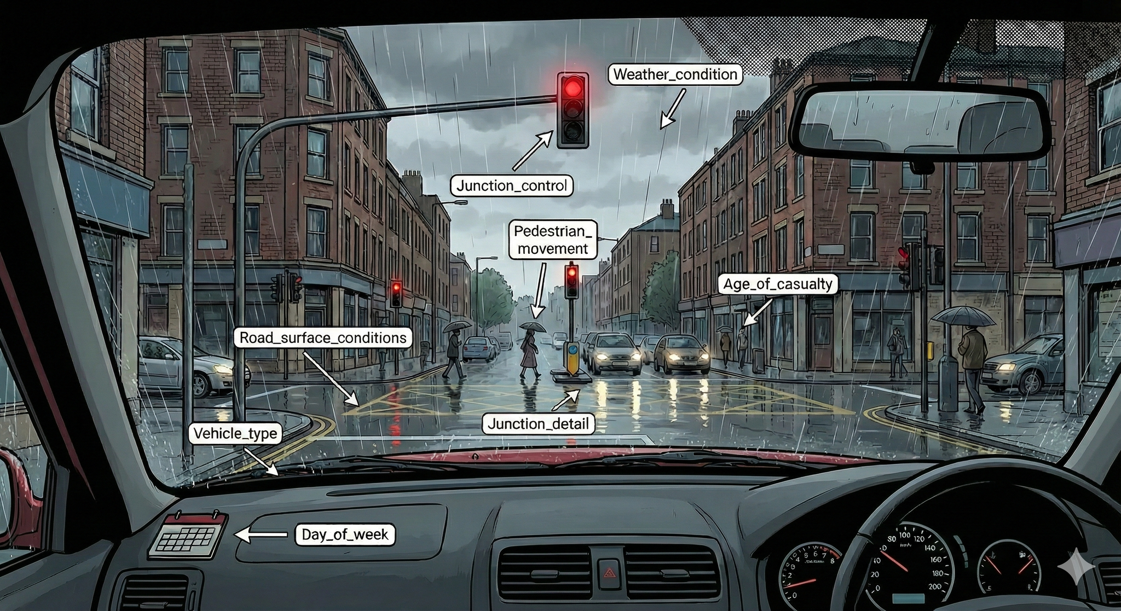
Data
Data Source: Road safety statistics (Gov.uk)
Collisions in 2024 in the UK
Dependent variable: Survival
Survival:
Fatal: 1
Non-fatal: 0

Slide 4


Methodology
Random forest
9 random forest models
Each had 200 trees
With a max depth of 10,20,30
And min leaf size of 1,5,10
5-fold cross validation
80 741 ~ 20 186 observations
Each tree uses
Balanced sampling (~98,5% non fatal, 1,5% fatal)
Sample size same as train set size (80 741)
6 random variables at each split
We calculated the average recall on test sets
The best random forest had:
Max depth: 10
Min leaf size: 10
Baseline models
Guess all injuries to be non-fatal
Our data was imbalanced (~1,5% fatal)
This model had ~98,5% accuracy
Guess randomly 1,5% to be fatal, 98,5% non-fatal
Almost the exact same results
Lasso logistic regression
λ = 0.1 parameter
34 variables
86 variables after splitting the categorical
variables into dummies
5-fold cross validation

Slide 5

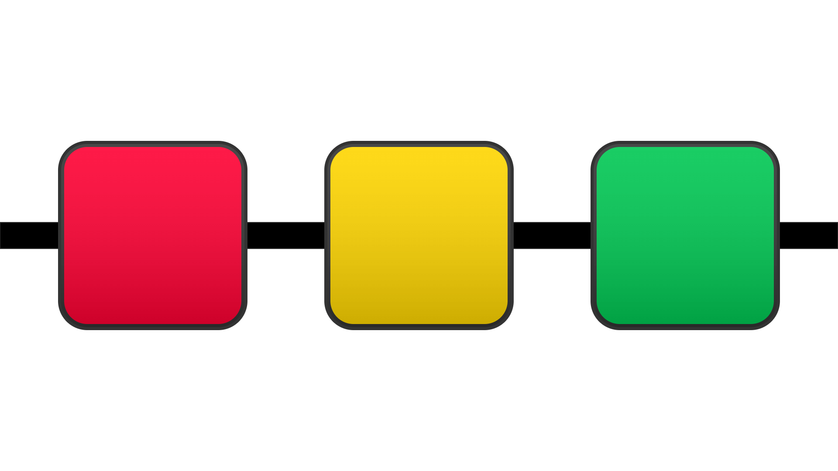
Methodology
Baseline Models
Lasso Logistic Regression
Random Forest
Baseline models
Guess all injuries to be non-fatal
Our data was imbalanced (~1,5% fatal)
This model had ~98,5% accuracy
Guess randomly 1,5% to be fatal, 98,5% non-fatal
Almost the exact same results

Slide 6
Methodology
Baseline Models
Lasso Logistic Regression
Random Forest
Lasso logistic regression
λ = 0.1 parameter
34 variables
86 variables after splitting the categorical variables into dummies
5-fold cross validation

Slide 7
Methodology
Baseline Models
Lasso Logistic Regression
Random Forest
Random forest
9 random forest models
Each had 200 trees
With a max depth of 10,20,30
And min leaf size of 1,5,10
5-fold cross validation
80 741 ~ 20 186 observations
Each tree uses
Balanced sampling (~98,5% non fatal, 1,5% fatal)
6 random variables at each split
We calculated the average recall on test sets
The best random forest had:
Max depth: 10
Min leaf size: 10

Slide 8
Model performance
Model | Accuracy | Recall (Fatal) | ROC AUC
Baseline (Majority Rule) | 98.5% | 0.0% | 0.50
Random Forest | 76.2% | 60.3% | 0.78
Lasso Logistic Regression | 73.5% | 71.7% | 0.80

Slide 9
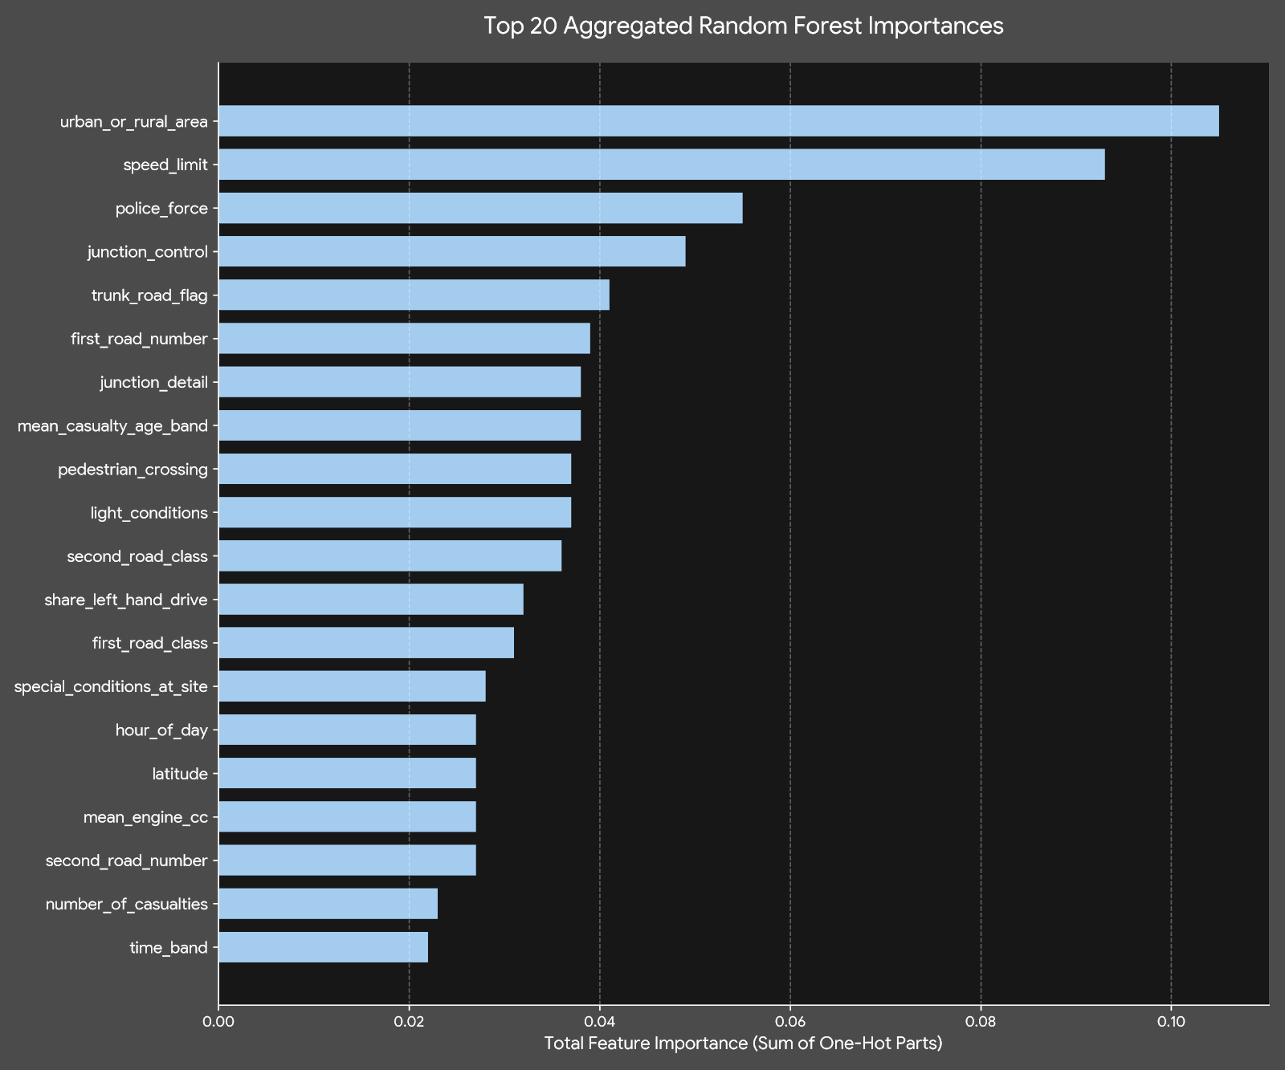
Influential variables
Consistent variables accross models
Outstanding variables from Random forest:
Urban or rural area
Speed limit
Outstanding variables from Logistic regression:
Age of casulty
Left hand drive vehichle
Speed limit

Slide 10

Rank | Random forest | Logistic Regression
1 | urban_or_rural_area | mean_casualty_age_band
2 | speed_limit | share_left_hand_drive
3 | police_force | speed_limit
4 | junction_control | first_road_class
5 | trunk_road_flag | first_road_number
6 | first_road_number | time_band
7 | mean_casualty_age_band | max_casualty_distance_band
8 | junction_detail | road_type
9 | light_conditions | urban_or_rural_area
10 | pedestrian_crossing | junction_control

Slide 11
Takeaways
Lasso Logistic Regression performs better
Almost 80% TP rate
Not recognizing a fatal collision is more problematic than classifying a non-fatal as fatal

Slide 12
Limitations
Looking at more than just one year
Not too long time series
→
Development in car safety
Looking at different countries
→
Different features might
be more relevant

Slide 13
Thank you for you attention!

